Slide 1
Parallel computing in R
December 1 2016
Parts of these notes are from Jacalyn Huband

Slide 2
Why parallel computing?
Save time
Work concurrently
Solve larger problems

Slide 3
Parallel Programming
“ … will become the mainstream of software development techniques due to a radical change in hardware technology.”
Parallel Programming: For Multicore and Cluster Systems
by Thomas Rauber and Gudula Rünger, 2010

Slide 4
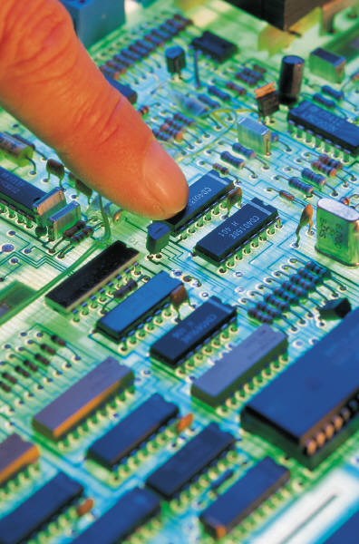
Hardware Basics
A single computer chip can hold multiple cores (i.e., computing units). The cores have access to the same memory, which makes them quite efficient.
Our laptop and desktop computers have the ability to do some parallel computing (and will be able to do increasingly more in the near future).
Dual core and quad core processor have become standard for most laptops and desktop computers.
Soon, desktop computers are expected to have 75 or more cores.
At the same time, we are seeing more computer clusters built from commodity hardware.

Slide 5

A Word of Caution
Not every large program should be parallelized.
Thought and planning are needed to determine when and how to parallelize a program.

Slide 6
Do you have what it takes?
Suppose you have a computational problem that is taking hours, days, or even weeks to solve . . .
Is parallelizing it an option?
Are there tasks that can be done in parallel?
Do you have the resources to run a parallel program?
Multiple cores on your computer
Rivanna cluster
Other (XCG, XSEDE)
Does your programming language allow parallel processing?
Across multiple cores
Across a cluster

Slide 7
R packages for parallel computing
parallel
doparallel

Slide 8
Simple example: doparallel
## Setup parallel backend to use multiple processors
cl <- makeCluster(6)
registerDoParallel(cl)
## Start program
results <- foreach(i = 1:numIters, .combine = cbind, .packages = c("nloptr")) %dopar% {
x <- iris[which(iris[,5] != "setosa"), c(1,5)]
ind <- sample(100, 100, replace=TRUE)
result1 <- glm(x[ind,2]~x[ind,1], family=binomial(logit))
## Save results
res[i] <- coefficients(result1)
## Combine all of our output into a list
result <- list(mean1 = coefficients(result1))
result
}
## Stop the cluster manually
stopCluster(cl)

Slide 9
Conclusion
Can get good speedup for free (though your computer will get hot)

Slide 10
Hoffman2 for high performance computing
UCLA’s supercomputing cluster
Vital if you have huge data and/or heavy-duty computation
Managed and operated by the IDRE Research Technology Group
1,200+ 64-bit nodes and 13,340 cores, over 50TB of memory

Slide 11
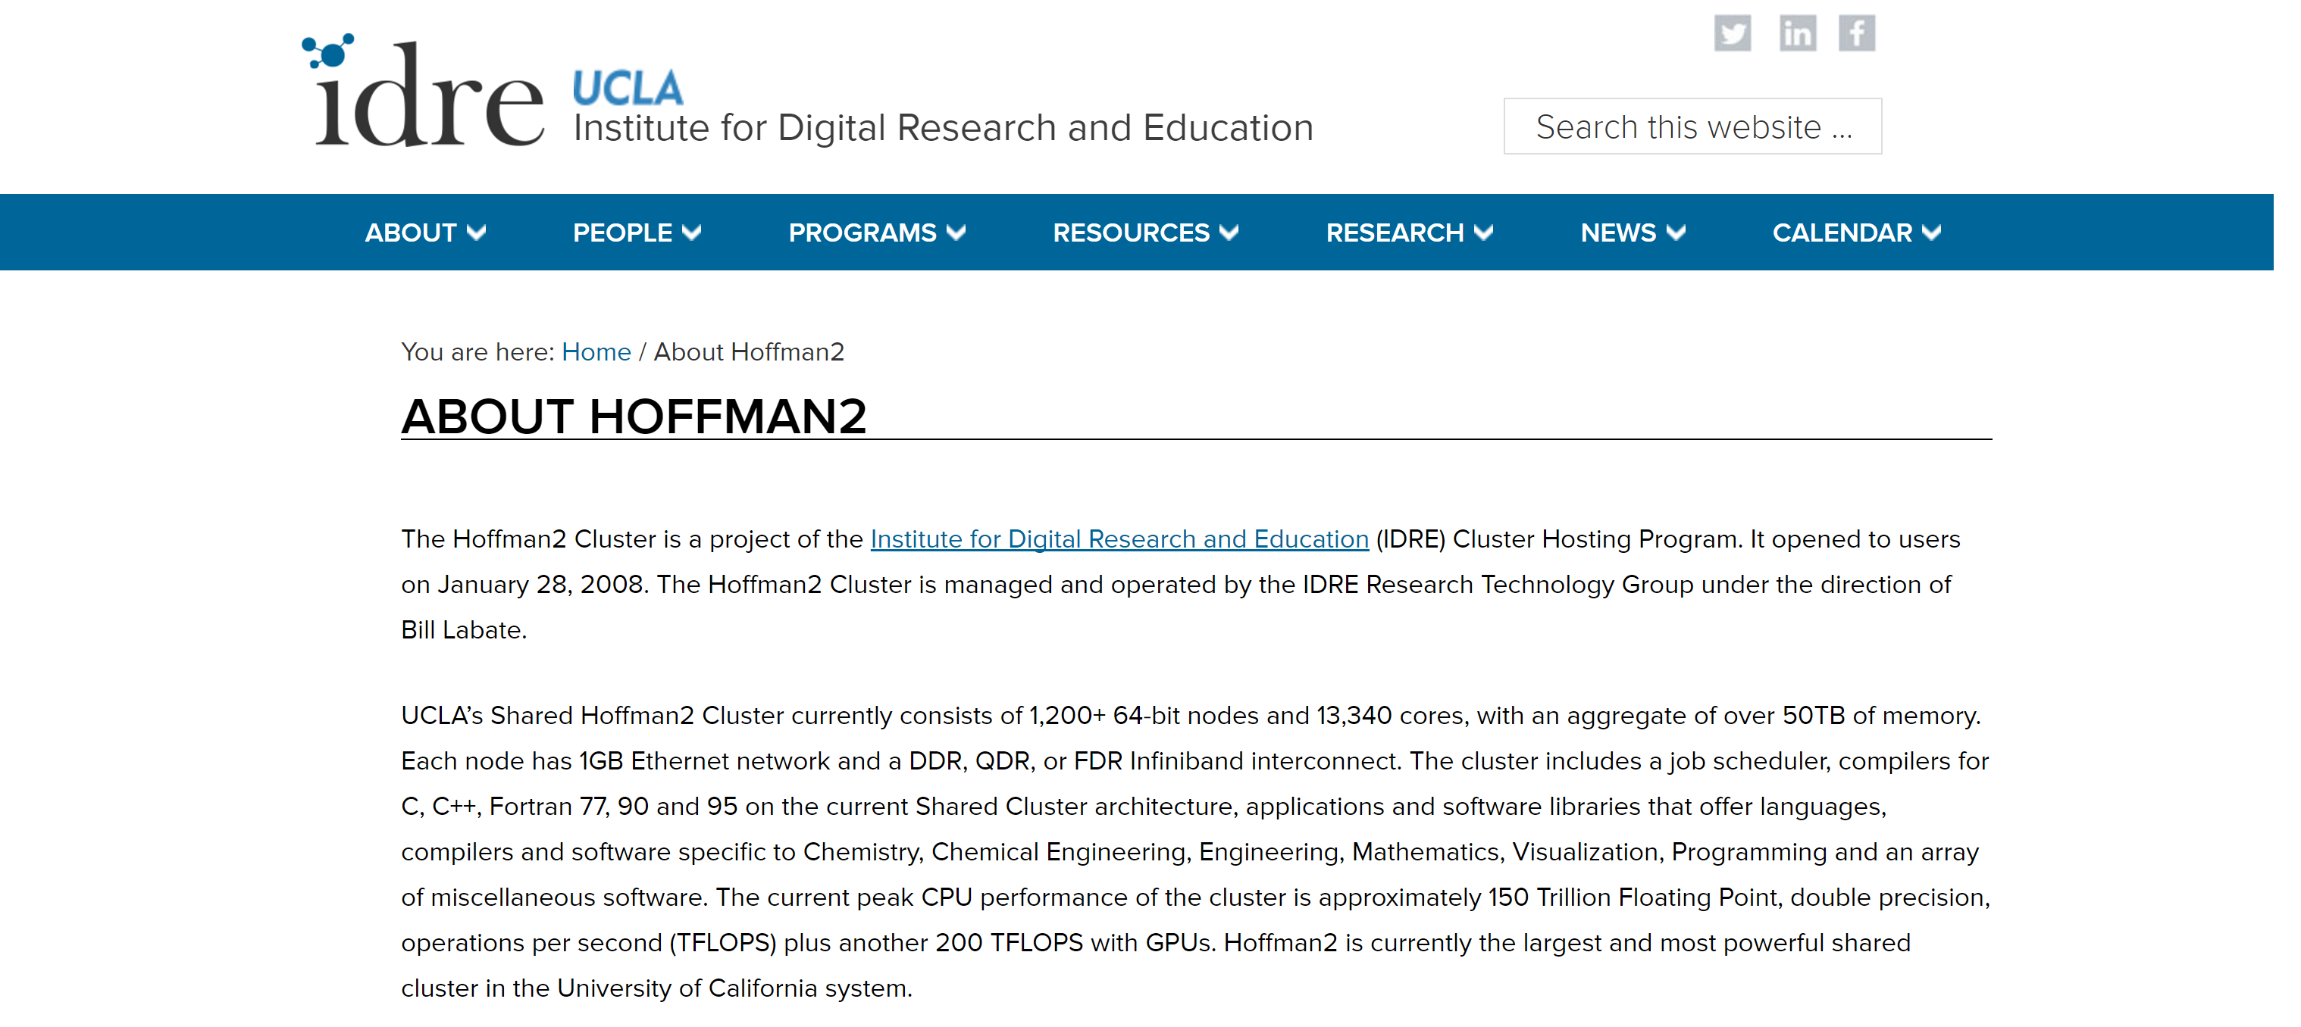
Hoffman 2

Slide 12
How to use Hoffman2?
Need to register with UCLA IDRE
Need a faculty sponsor (they may have to pay $$$)
IDRE gives workshops fairly frequently on using Hoffman (check their website)

Slide 13
Connecting to Hoffman2
Can use an SSH client like “MobaXterm”
Can use remote desktop “NoMachine”
See Hoffman site for more details

Slide 14
High performance computing
Submit jobs (e.g. simulations) to UCLA’s computer, sit back and watch a movie
Need to learn basic UNIX commands
Makes life great

